Slide 1


Travel world
NAME – Shanti Kumari
Class – B.C.A Final Year
Roll No - 405

Slide 2

Introduction to the project
The Project travel world deal with the tool and travel services, package, online reservations system etc. This is an online hotel where anyone can search for there all the requirement and choose the best and suitable package with in their budgets.

Slide 3
Objective of project :- The main objective of this website is to provide traveling online registration all type of purpose. Our objective also given below:-
To manage all the travel requirements of the companies while providing ease and short of convenience to the customers while proving ease and sort of convenience to the customers.
To add value to the travel sector of different companies.
To offer the traveling services are very reasonable prices.

Slide 4
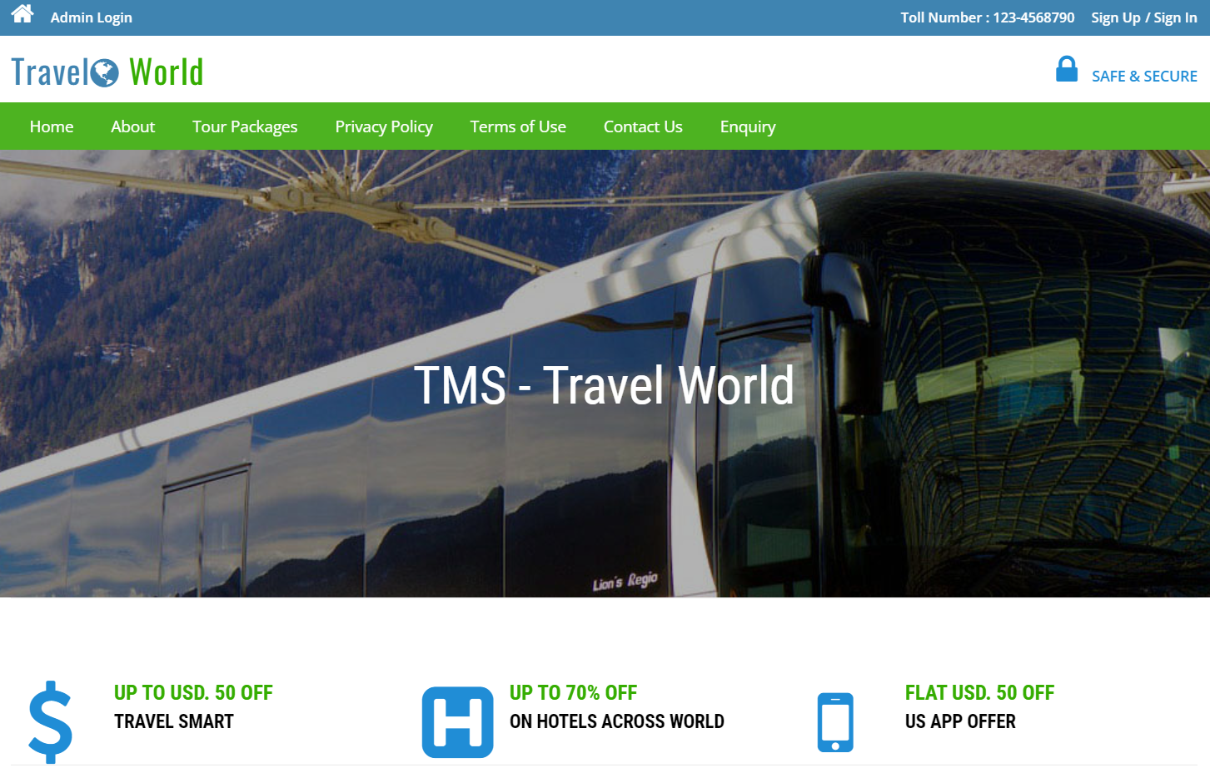
Tour module
First click the open home of website

Slide 5
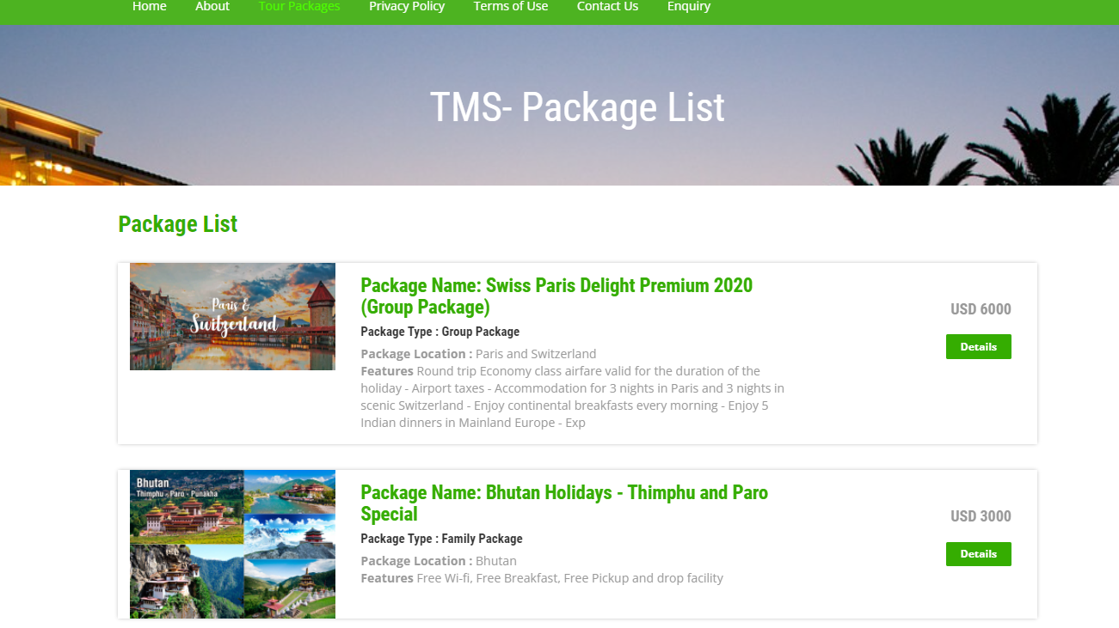
Click to open Package page

Slide 6
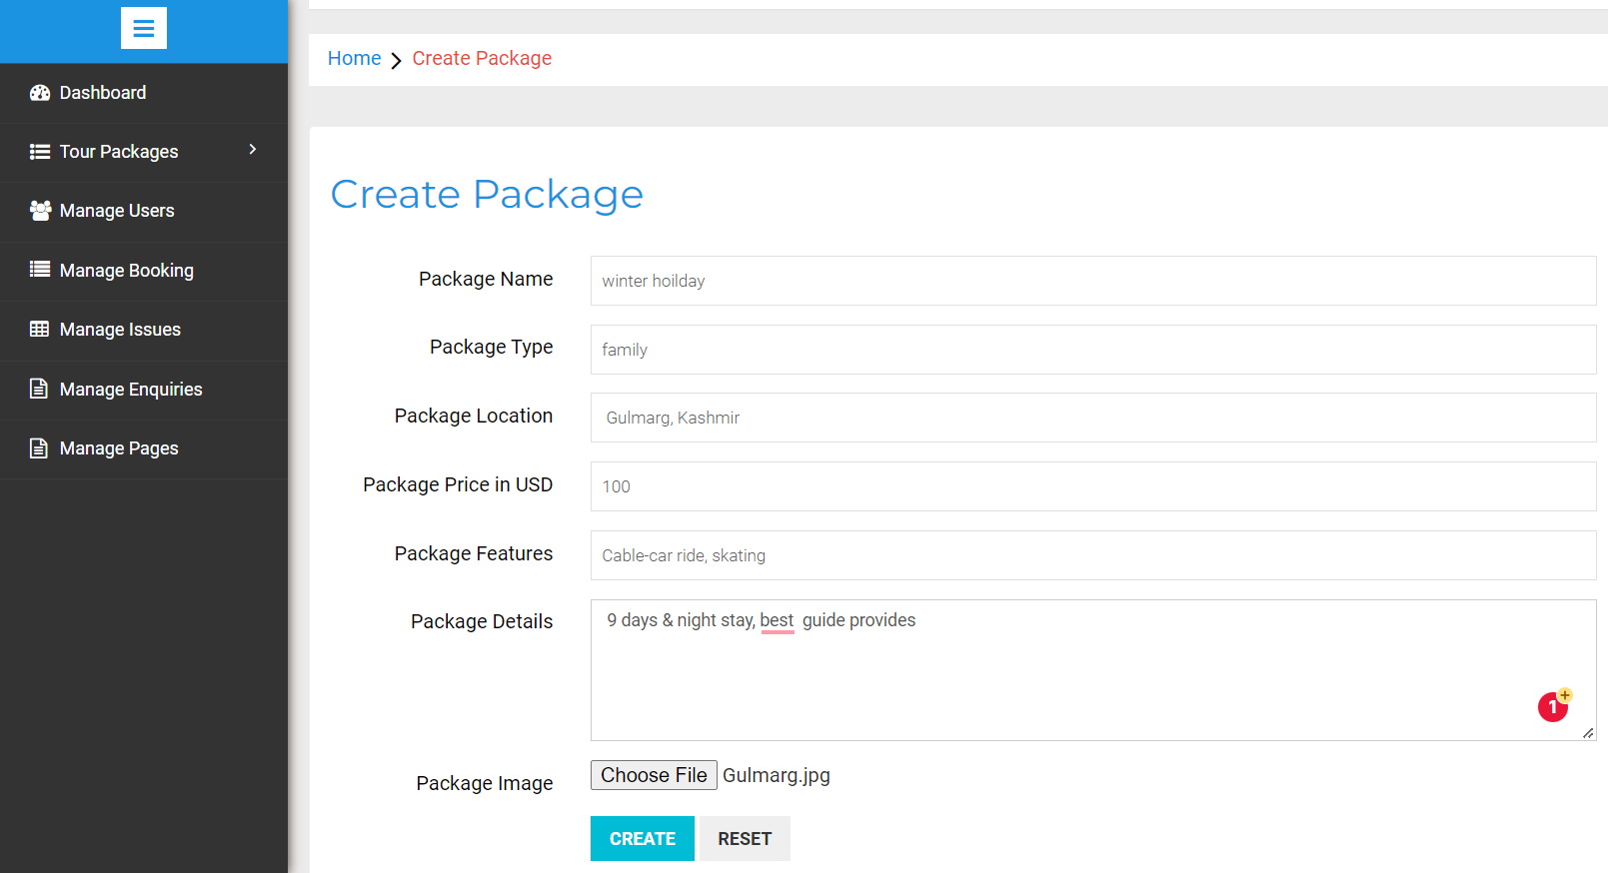
Create new package

Slide 7
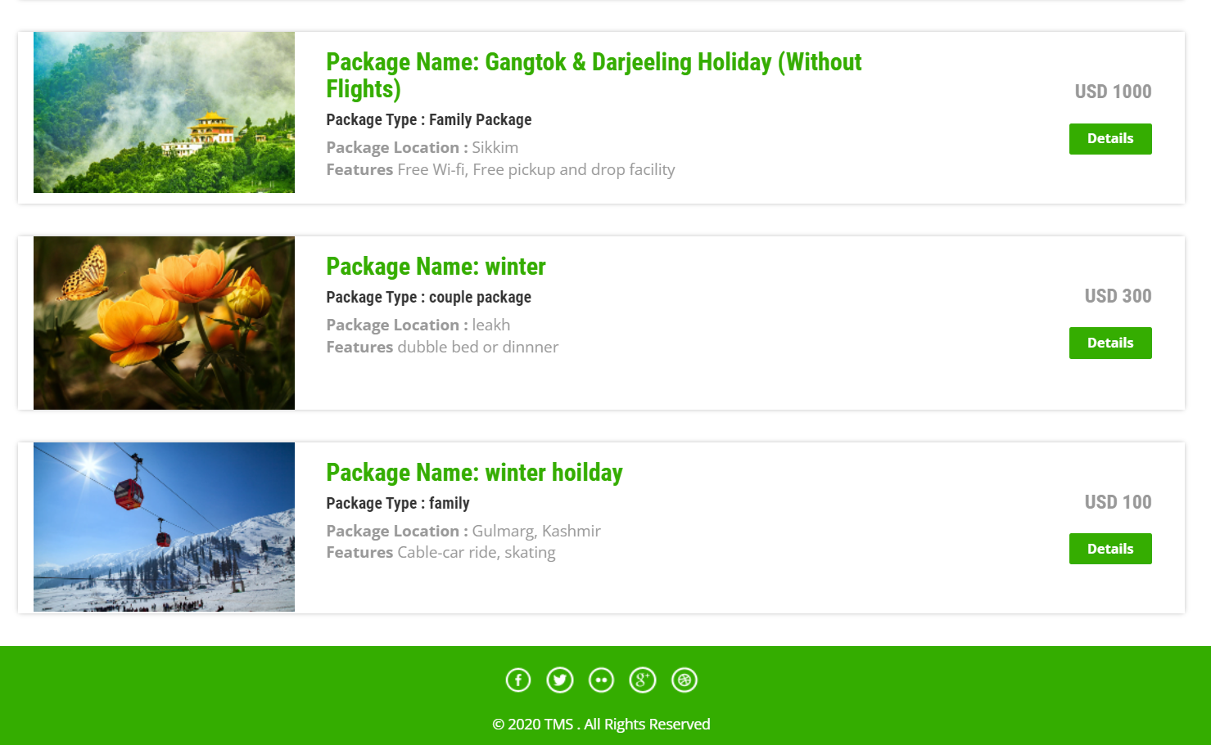
After create a new package see in this list.

Slide 8
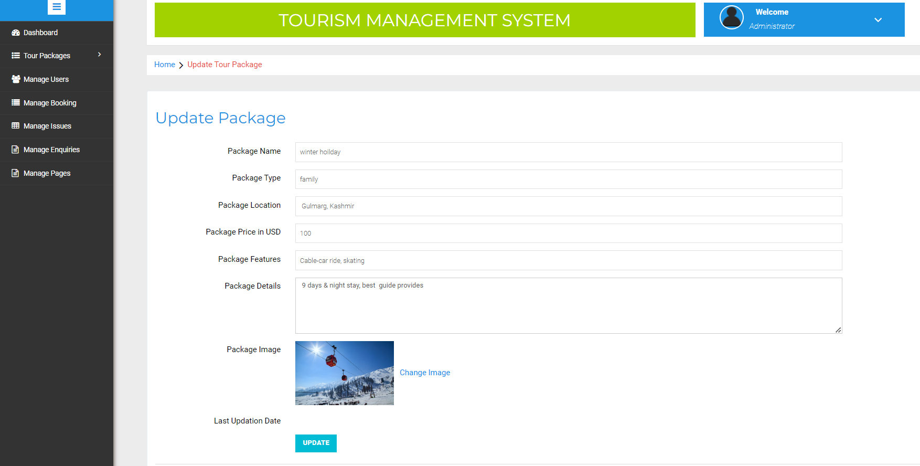
Update the package details

Slide 9
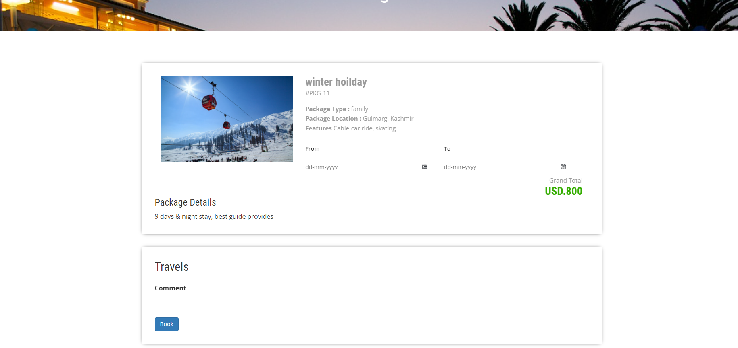
Check details of the package

Slide 10
THANK TO ALL

